Slide 1
Duck Simulator
Md. Siamul Mubin Tamim
ID: 200042130

Slide 2
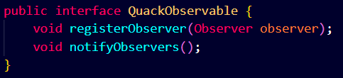
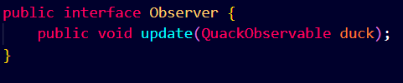
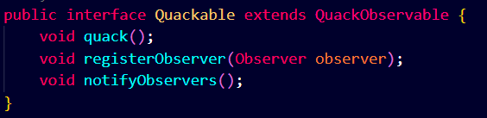
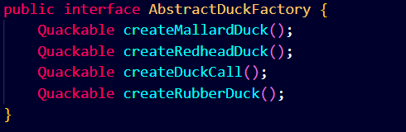
Classes and Interfaces - Their usages
Interfaces:
QuackObservable
Observer
Quackable
AbstractDuckFactory
Duck Simulator
2

Slide 3
Classes and Interfaces - Their usages
Classes:
DuckFactory
MallardDuck
RedheadDuck
RubberDuck
DuckCall
Goose
GooseAdapter
Flock
CountingDuckFactory
Observable
QuackCounter
Quackologist
DuckSimulator
Duck Simulator
3

Slide 4
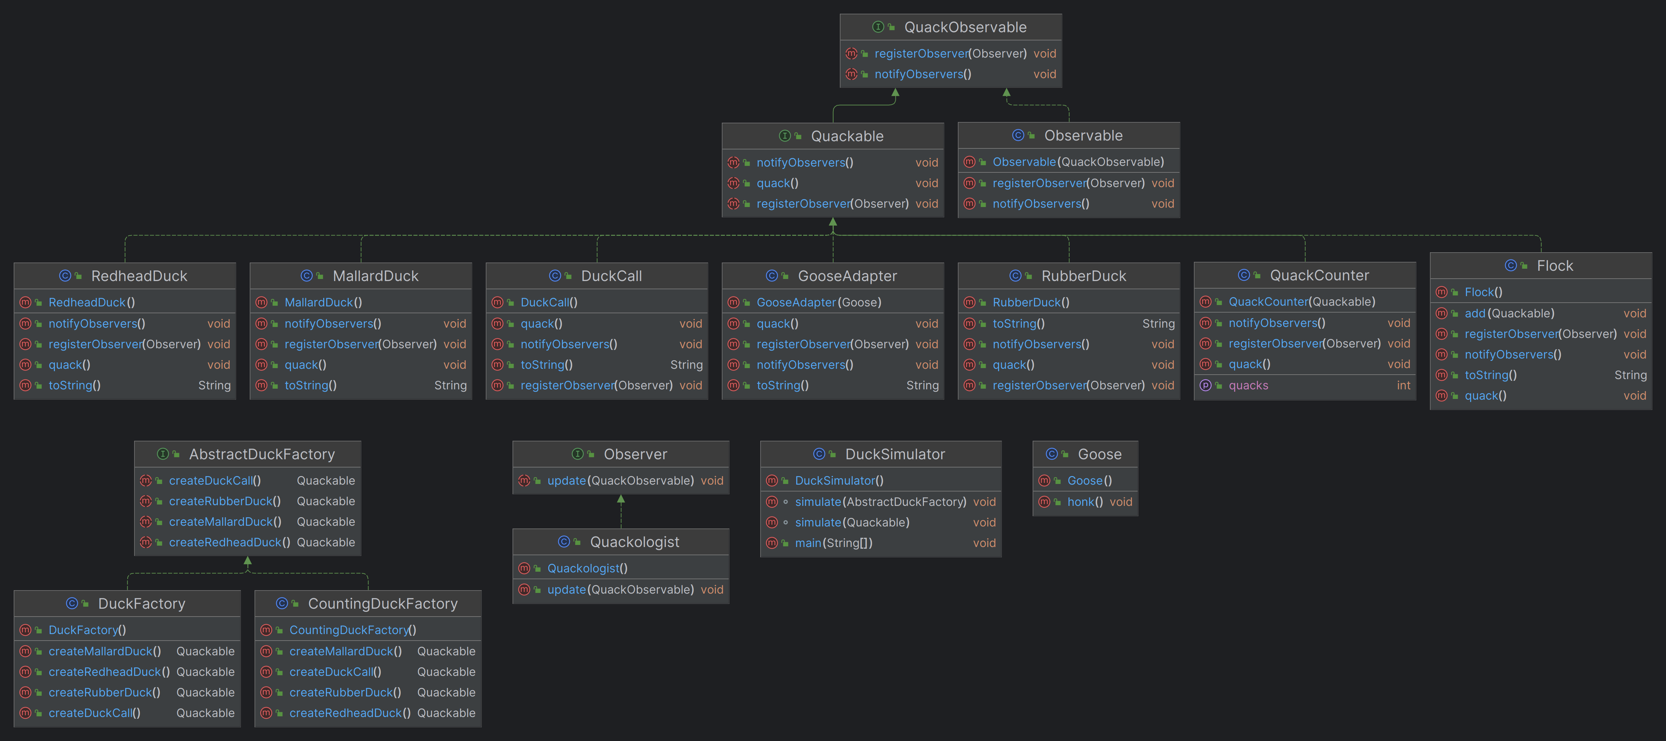
UML Class Diagram
Duck Simulator
4

Slide 5
Patterns used in the project
Observer Pattern:
Classes/Interfaces Involved: Observer, QuackObservable, Quackologist, Observable
Usage: The observer pattern is used to implement the behavior where the Quackologist observes QuackObservable instances (ducks) to be notified when they quack.
2. Decorator Pattern:
Classes/Interfaces Involved: Quackable, QuackCounter
Usage: The decorator pattern adds behavior (counting quacks) to the Quackable ducks. QuackCounter wraps around another Quackable and adds counting functionality.
3. Composite Pattern:
Classes/Interfaces Involved: Quackable, Flock
Usage: The composite pattern is used to treat both individual ducks and groups of ducks uniformly. The Flock class is a composite of multiple Quackable objects, allowing them to be treated as a single unit.
Duck Simulator
5

Slide 6
Patterns used in the project
4. Factory Pattern:
Classes/Interfaces Involved: AbstractDuckFactory, DuckFactory, CountingDuckFactory
Usage: The factory method pattern is used to create families of related objects. AbstractDuckFactory defines the interface for creating ducks, and DuckFactory and CountingDuckFactory are concrete implementations that create different types of ducks.
5. Adapter Pattern:
Classes/Interfaces Involved: GooseAdapter
Usage: The adapter pattern is used to make a Goose object compatible with the Quackable interface. GooseAdapter adapts the Goose class to behave like a duck.
Duck Simulator
6

Slide 7
Demonstration
Duck Simulator
7

